Slide 1
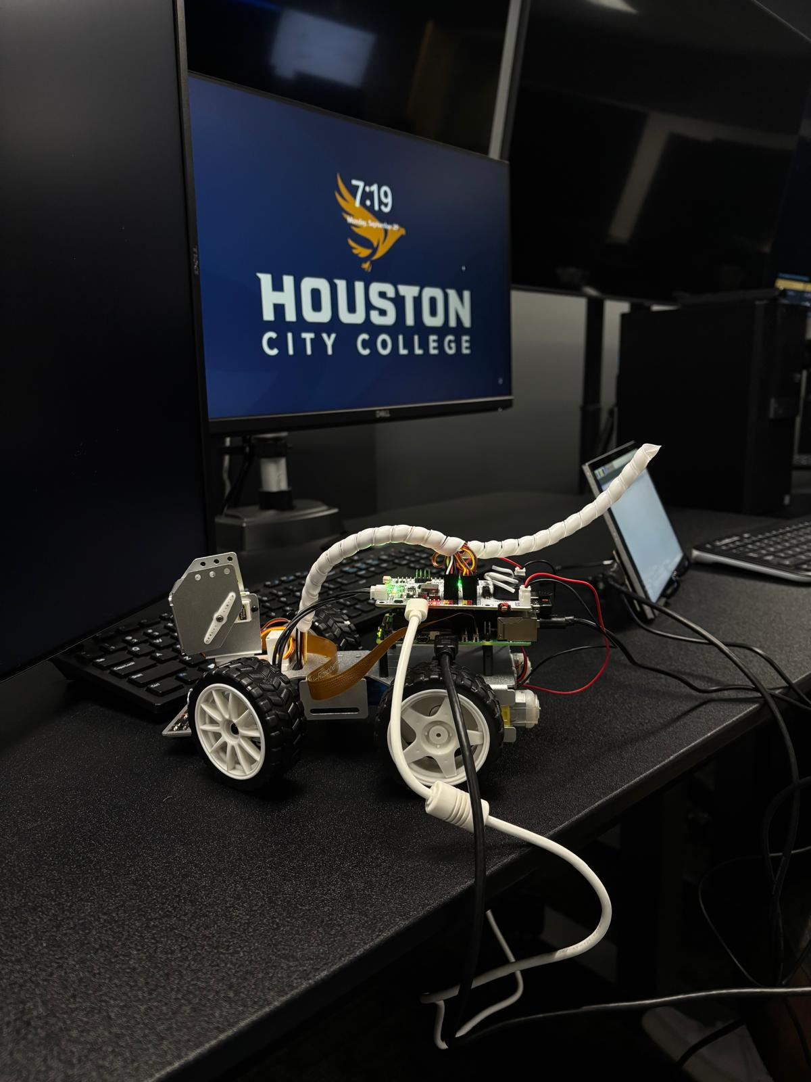
Raspberry Pi5
Robot Hat
Aima Ayaz
Ezra Bakatubia
ITAI 2374
Notes:
Key Hardware Features of Raspberry Pi 5, Connectivity and Expansion Options, Applications in Edge Computing and Robotics

Slide 2
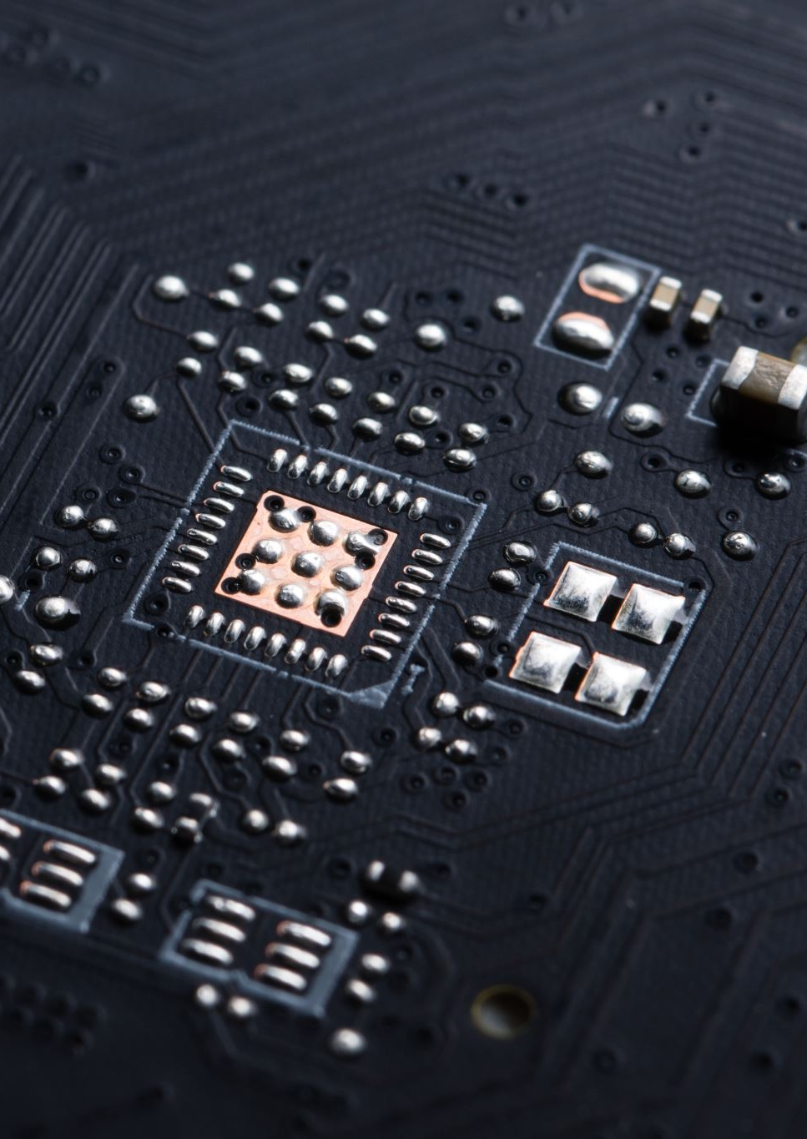
Raspberry Pi 5 Overview (Released October 2023)
Key features include:
RAM options: 2GB, 4GB, or 8GB LPDDR4X
Connectivity: Dual-band Wi-Fi (802.11ac), Bluetooth 5.0/BLE
Ports: 2× USB 3.0, 2× USB 2.0, Gigabit Ethernet with PoE+ support
Expansion: PCIe 2.0 x1 interface, 2× MIPI camera/display transceivers
Storage: High-speed microSD slot (SDR104 mode)
Extras: Real-time clock (RTC), power button, 40-pin GPIO header
Notes:
The Raspberry Pi 5 marks a significant leap in the evolution of single-board computing. Released in 2023, it empowers developers, educators, and hobbyists with enhanced performance and flexibility for modern applications. Whether you're building smart robots, running edge AI models, or exploring embedded systems, the Pi 5 offers a robust platform for innovation and experimentation.

Slide 3
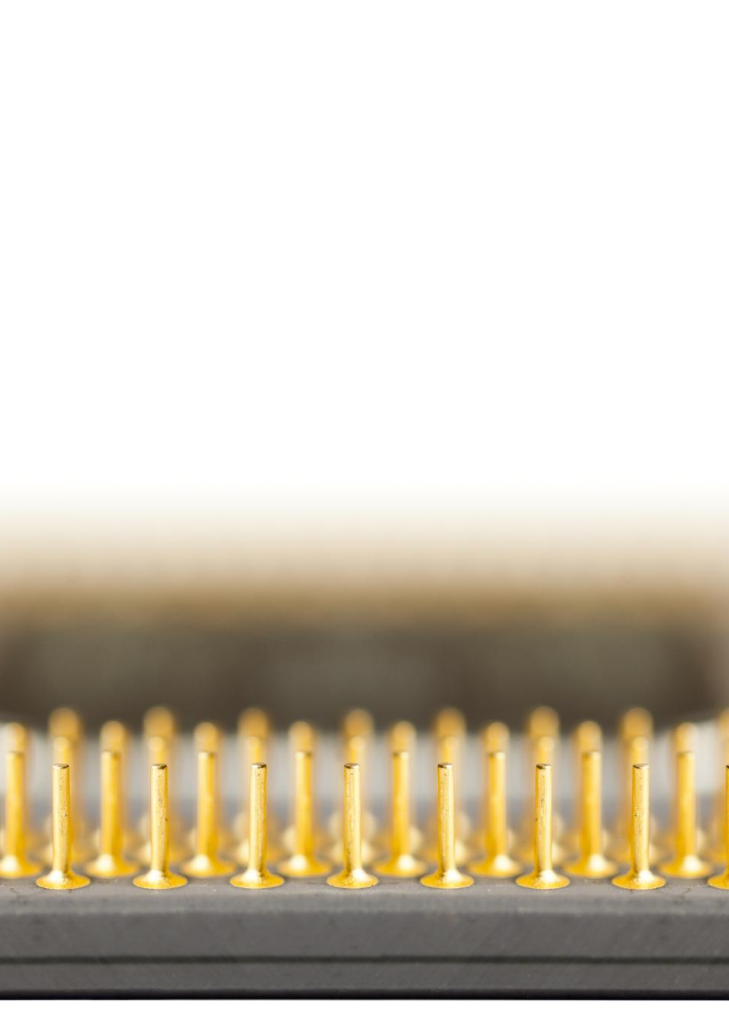
Key Hardware Features of Raspberry Pi 5
Powerful Processor
  Features a quad-core Cortex-A76 CPU clocked at 2.4GHz to handle demanding computing tasks efficiently.
Advanced Graphics Processing
  Includes the VideoCore VII GPU for enhanced graphics performance and multimedia capabilities.
Expanded Memory Capacity
  Offers up to 8GB of RAM for smooth multitasking and handling memory-intensive projects.
Notes:
Raspberry Pi 5 boasts significant upgrades, including a quad-core Cortex-A76 CPU running at 2.4GHz, the VideoCore VII GPU, and up to 8GB of RAM. These features enhance performance for demanding applications and provide improved support for multitasking, making it ideal for advanced projects and educational uses.

Slide 4

Connectivity and Expansion Options
Dual 4K HDMI Outputs
  Supports connection of multiple 4K displays for enhanced visual experience and productivity.
PCIe 2.0 Support
  Provides high-speed expansion capabilities for graphics cards and other peripherals.
USB 3.0 Connectivity
  Enables fast data transfer and connection with a wide range of USB peripherals.
Notes:
This latest model includes dual 4K HDMI outputs, PCIe 2.0 support, and USB 3.0 connectivity. These expansion options allow for flexible interfacing with various peripherals, faster data transfer, and the ability to connect multiple displays, making it suitable for multimedia and development environments.

Slide 5
Applications in Edge Computing and Robotics
Edge Computing Capabilities
  Raspberry Pi 5 supports real-time data processing at the edge, minimizing latency and enhancing efficiency.
Robotics Control
  Its processing power enables autonomous robot control for both hobbyist and professional robotics projects.
AI Image Recognition
  Supports AI-powered vision tasks such as image recognition with enhanced connectivity and computing power.
Notes:
The Raspberry Pi 5 serves as a capable platform for edge computing, enabling real-time data processing directly on the device. This reduces latency and enhances system responsiveness, which is critical for time-sensitive applications. In robotics, its computational power supports autonomous control, sensor integration, and decision-making in both educational and professional contexts. Additionally, the device facilitates AI-driven image recognition tasks, leveraging its improved processing capabilities and connectivity to support vision-based systems.

Slide 6
Raspberry Pi 5 Robot HAT
The Robot HAT is an expansion board that transforms the Raspberry Pi 5 into a full-featured robotics controller. It adds motor drivers, sensor interfaces, and audio capabilities — ideal for building smart cars, robotic arms, or voice-controlled bots.
Notes:
The Robot HAT is a versatile expansion board designed to extend the capabilities of the Raspberry Pi 5 for robotics applications. It integrates essential hardware interfaces that support motor control, sensor input, and audio output, enabling the development of intelligent and interactive robotic systems. With built-in support for multiple communication protocols such as PWM, I2C, SPI, UART, and ADC, the Robot HAT facilitates seamless integration with a wide range of components including DC motors, servo motors, ultrasonic sensors, and infrared modules.
Its onboard microphone and speaker also allow for basic voice interaction, making it suitable for projects involving speech-based control or feedback. Whether used in educational settings, hobbyist builds, or prototype development, the Robot HAT transforms the Raspberry Pi 5 into a compact yet powerful robotics controller capable of supporting autonomous behavior and real-time decision-making.

Slide 7
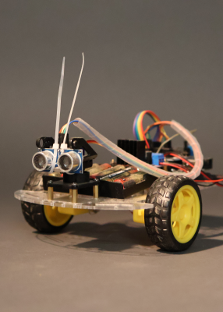
Key features:
Controls up to 4 DC motors and 16 servo motors
Supports ultrasonic, IR, and line-tracking sensors
Includes PWM, ADC, I2C, UART, and SPI interfaces
Built-in microphone, speaker, and voice interaction support
Compatible with Raspberry Pi 5, 4, 3B+, and Zero W
This Photo by Unknown Author is licensed under CC BY-SA-NC

